Slide 1



RoboMapperX: An Autonomous Robot
Presenter: Laasya Lata Anumkonda

Slide 2

Agenda
Introduction to the project
Importance of Autonomous Navigation
Literature review
Project Methodology Overview
Challenges
Key Concepts and tools
Results
Future Enhancement
Conclusion
Reference

Slide 3

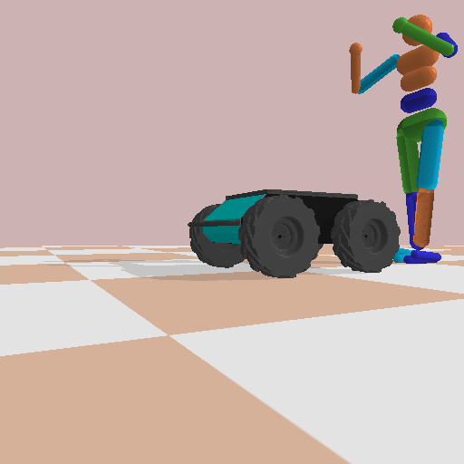
Introduction
RoboMapperX is an autonomous robot capable of navigating and mapping open areas while avoiding obstacles.

Slide 4

Importance of Autonomous Navigation
Search and Rescue operations in hazardous areas.
Environmental Monitoring
Precision Agriculture
Notes:
Autonomous robots can enter dangerous environments, such as disaster zones or industrial sites, without risking human lives.
They can survey remote locations, gather data on environmental conditions, and contribute to conservation efforts.
They can map farmland, monitor crop health, and optimize resource utilization for sustainable farming practices.

Slide 5
Literature Review
YOLO v3-Tiny: Object Detection and Recognition using one stage improved model: This paper introduced an improved model for object detection and recognition, offering valuable insights for implementing the YOLOv3 algorithm in this project. (Link)
Autonomous Mobile Robot Navigation in Indoor Environments: Mapping, Localization, and Planning: This has paper discussed about strategies for autonomous navigation in indoor environments, providing insights into mapping, localization, and planning techniques relevant to this project. (Link)
ROBOG: An autonomously navigating vehicle based on road detection for unstructured road: This paper has explored a vehicle navigation system based on road detection, offering valuable algorithms for obstacle detection and navigation in unstructured environments. (Link)

Slide 6
Challenges
Autonomous navigation in complex and dynamic environments.
Accurate and efficient object detection for identifying target objects.
Effective obstacle avoidance to ensure safe traversal.
Creation of detailed maps for spatial awareness and path planning.
Notes:
Navigating through unpredictable and changing environments poses challenges such as varied terrains, dynamic obstacles.
Identifying specific objects of interest, such as individuals in search and rescue missions or anomalies in environmental monitoring, requires precise and reliable object detection algorithms.
Avoiding collisions with obstacles, both static and dynamic, is essential for the safety and efficiency of autonomous robots operating in diverse environments.
Generating comprehensive maps of the surroundings is crucial for spatial awareness, path planning, and decision-making during navigation.

Slide 7


Project Methodology Overview
YOLOv3 You Only Look Once Algorithm
Virtual environment simulation and OpenCV
Virtual Global Positioning System Sensors
It is a deep Learning model used for real-time object detection
This enables robot to perceive the environment in 3D for Depth Mapping and Obstacle Avoidance
It provides location and orientation information for robot within a simulated environment.
Notes:
1. YOLOv3: Working: It divides the input image into a grid and predicts bounding boxes and class probabilities directly from the full image. It is trained on a diverse dataset containing images of target objects, annotated with bounding boxes and class labels.
Stereo Cameras: capture images from two slightly offset viewpoints, mimicking human binocular vision. This setup allows for the calculation of depth information using triangulation techniques. OpenCV, a computer vision library, is used for stereo camera calibration, rectification, and depth map generation.
2. Simulation software(Gazebo): Create or import a 3D environment that represents the real-world environment where your robot will operate. This can include indoor spaces, outdoor terrains, or custom environments. Define the terrain, objects, obstacles, walls, and other elements in the simulation environment. Implement control algorithms and navigation scripts for the robot in the simulation environment. This can include path planning algorithms, obstacle avoidance strategies, and motion control commands.
3. Virtual GPS sensor in Gazebo: In Gazebo, the virtual GPS sensor simulates real GPS functionality by providing the robot's position, velocity, and time within the simulated environment. It generates signals that mimic satellite reception, enabling autonomous navigation and movement control. This data is crucial for path planning, waypoint navigation, and synchronization with the robot's internal clock. While not communicating with actual satellites, the virtual GPS sensor accurately replicates GPS features, aiding in realistic robotic simulations and decision-making processes within Gazebo.

Slide 8

Key Concepts and Tools used
Pybullet for creating a simulated environment.
OpenCV for camera calibration and depth map generation.
ImageAI library for implementing the YOLOv3 model.
LabelImg tool for annotating training data.
Google Colab for training the deep learning model.

Slide 9
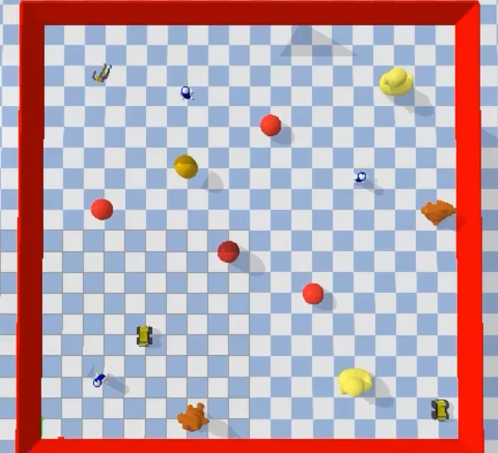
Results

Slide 10

Future Enhancement
Multi-Level Mapping: Develop multi-level mapping capabilities to handle complex environments with multiple floors or levels.
Environmental Sensing: Enhance the robot's environmental sensing capabilities by integrating additional sensors, such as gas sensors for detecting pollutants or environmental sensors for monitoring temperature and humidity.
Indoor Navigation for Visually Impaired by Semantic Mapping: Creating detailed indoor maps with annotations for navigation aids (e.g., doorways, stairs, obstacles) for visually impaired individuals.
Notes:
1. For instance, enable the robot to create and navigate 3D maps of buildings or outdoor areas with varying elevations, stairs, and obstacles, enhancing its versatility in different scenarios.
2. Use this data to create more comprehensive environmental maps and support applications like environmental monitoring or pollution detection.
3. For example, enable the robot to remember key landmarks, safe paths, or restricted areas in the environment, improving its efficiency and safety during subsequent navigation tasks in familiar areas.Implementing voice-based commands and tactile feedback mechanisms to facilitate intuitive interaction between the robot and users, providing assistance in indoor navigation tasks. - Human-Robot Interaction

Slide 11

Conclusion
RoboMapperX has achieved successful simulation overcoming challenges in object detection, obstacle avoidance, and mapping within a virtual environment.

Slide 12

References
https://pybullet.org/
https://opencv.org/
https://github.com/OlafenwaMoses/ImageAI (Image AI library )
https://github.com/tzutalin/labelImg (LabelImg tool)
https://arxiv.org/abs/1808.01974

Slide 13
Thank you!

